Slide 1
Overview

Slide 2
Office 365 Environment
Office
Exchange
SharePoint
OneDrive for Business
Azure Active Directory (AAD)
Notes:
SharePoint Online provides a solid business collaboration platform on which developers can build solutions quickly by using familiar development tools. In addition to in-browser customizations, SharePoint Online supports development with Microsoft SharePoint Designer 2010, Microsoft Visual Studio 2010, and Microsoft Visual Studio Team Foundation Server 2010. SharePoint Online enables you to modify sites directly and deploy code as sandboxed solutions that are run in a protected environment to safeguard the environment from poorly performing or malicious code.
SharePoint Online opens a new arena for developers to create solutions for customers who use the Office 365 service instead of maintaining on-premises servers, or for clients who want to take advantage of hybrid deployments where some data is stored behind the firewall and other data is off-loaded in the cloud.

Slide 3
Azure Active Directory
Identity and Access Management for the cloud
Can create new directories or manage existing ones in Azure subscription
Used by Office 365 for authentication
Used by Azure for user authentication and application authorization
Notes:
Azure Active Directory is a comprehensive identity and access management cloud solution. It combines core directory services, advanced identity governance, security, and application access management. Azure AD also offers developers an identity management platform to deliver access control to their applications, based on centralized policy and rules.

Slide 4
Office 365 Development Options
 | Apps for SharePoint | Apps for Office | Office 365 APIs
Word Excel |  | Task Pane App Content App
Outlook |  | Mail App | Mail Calendar Contacts
SharePoint | SharePoint-Hosted App Cloud-Hosted App |  | Files Sites
OneDrive for Business |  |  | Files

Slide 5
Windows Azure Environment
Azure Active Directory (AAD)
Azure Access Control Services (ACS)
Azure Web Sites

Slide 6
Azure Access Control Services
Identity and Access Management for the cloud
More generic than AAD
Can create new namespaces in Azure subscription
Used by Office 365 for application authorization
Notes:
Windows Azure Access Control Service (ACS) is a Windows cloud-based service that provides an easy way of authenticating and authorizing users to gain access to web applications and services while allowing the features of authentication and authorization to be factored out of the application code. This facilitates application development while at the same time providing users the benefit of being able to log into multiple applications with a reduced number of authentications, and in some cases only one authentication.

Slide 7
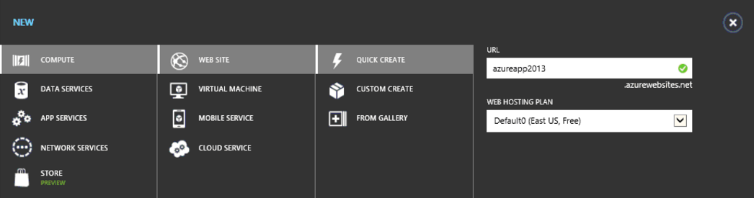
Azure Web Sites

Slide 8
Office 365 and Azure
Office 365 users can be managed in Azure
Office 365 users can be Azure administrators

Slide 9
Office 365 APIs Dev Environment
Office 365 Office and Exchange
Windows Azure Subscription (or other infrastructure)
Windows 8.1
Visual Studio 2013 (or other IDE)
Office 365 API Tools

Slide 10
Setting up Environments
Sign up for an Office 365 subscription
Create a Developer Site Collection
Sign up for Windows Azure subscription
Link Office 365 AAD to Windows Azure
Make Office 365 user administrator in Windows Azure
Use Visual Studio remotely to develop

Slide 11
The Office 365 Environment

Slide 12
Office Dev Center
Content
Samples
Documentation
Sign up for an Office 365 Developer Site
http://msdn.microsoft.com/en-us/library/office/fp179924(v=office.15).aspx
Notes:
Find how-to content, sample code, SDK and API documentation, VBA references, training, and articles for developing solutions and customizing Office applications and SharePoint products and technologies, including client applications, services, tools, and technologies such as apps for Office, apps for SharePoint, Access, Excel, Exchange, Lync, SharePoint Server, SharePoint Foundation, Skype, and Word.
Use an Office 365 Developer Site as a development and testing environment to shorten your setup time and start creating, testing, and deploying your apps for Office and SharePoint. Deploy the "Napa" Office 365 Development Tools to this preconfigured SharePoint site and you also get a head start on developing SharePoint-hosted apps, and apps for Office documents and mail items, without installing Visual Studio 2012 and Office Developer Tools for Visual Studio 2013 on your development computer. With an Office 365 Developer Site, you get an isolated app domain for SharePoint-hosted apps, preconfigured to use OAuth, so that you can use the Microsoft Azure Access Control Service (ACS) for authenticating and authorizing provider-hosted apps for SharePoint that are deployed to this site.

Slide 13
Developer Site Collection
Required for remote app development
Created automatically if you sign up for an Office 365 Developer Site
Use the Developer Site template to create a new Site Collection in an existing tenancy
Notes:
An Office 365 Developer Site makes it easier to get set up and start creating, testing, and deploying your apps for Office and SharePoint more quickly. Office 365 enterprise (E3 or E4) subscriptions include a site template you can use to create a Developer Site.

Slide 14
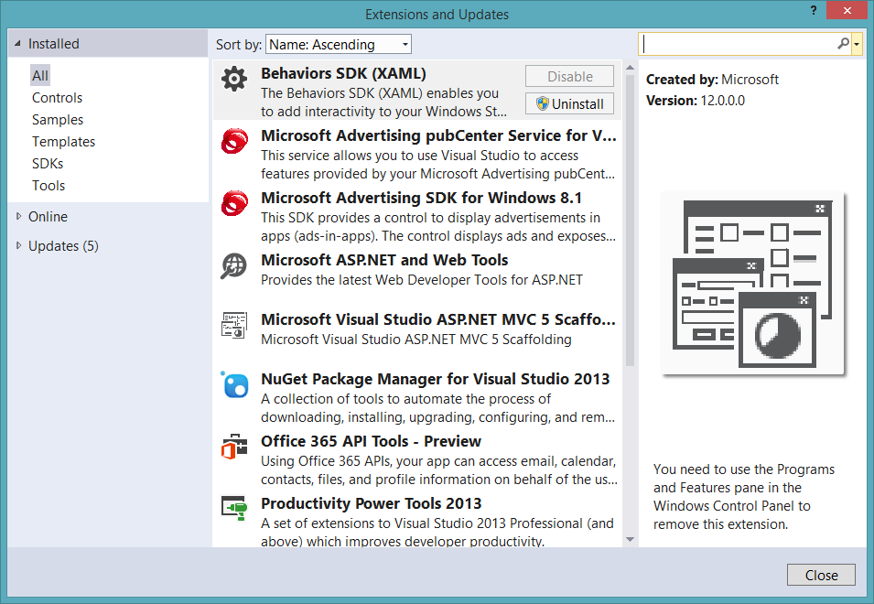
Visual Studio 2013
90-Day Trial
http://www.visualstudio.com/en-us/downloads/download-visual-studio-vs.aspx
Office 365 API Tools

Slide 15
demo
Obtaining an Office 365 Developer Subscription

Slide 16
The Windows Azure Environment

Slide 17
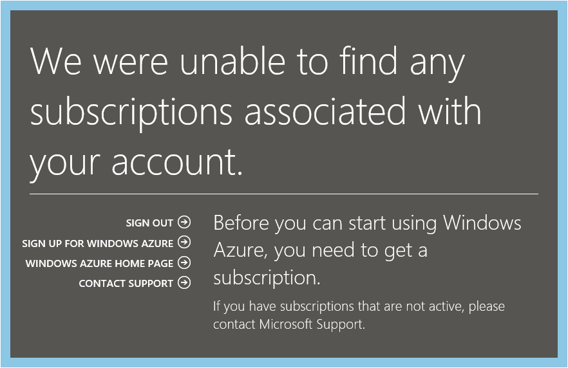
Azure Subscription
Navigate to Azure Portal using Office 365 credentials
When prompted, sign up for a trial

Slide 18
Link Office 365 and Azure
Log into Microsoft Azure subscription as administrator
Click on the Active Directory link.
Click New>Active Directory>Directory>Custom Create
Select to Add an Existing Directory
Follow the steps to add an existing directory
Notes:
It’s not required to link the Office 365 Directory to an Azure subscription
for simply creating provider-hosted apps, but it makes life a bit easier
and opens up the ability to call into Office 365 from other applications.

Slide 19
Office 365 Account as Azure Admin
Log into an existing Microsoft Azure as administrator
Click the Settings link
Click Administrators
Click Add
Add the Organizational Account from Office 365
Notes:
By adding an Office 365 account as an Azure administrator,
you can use a single account for managing both subscriptions

Slide 20
demo
Obtaining a Windows Azure trial Subscription

